Slide 1


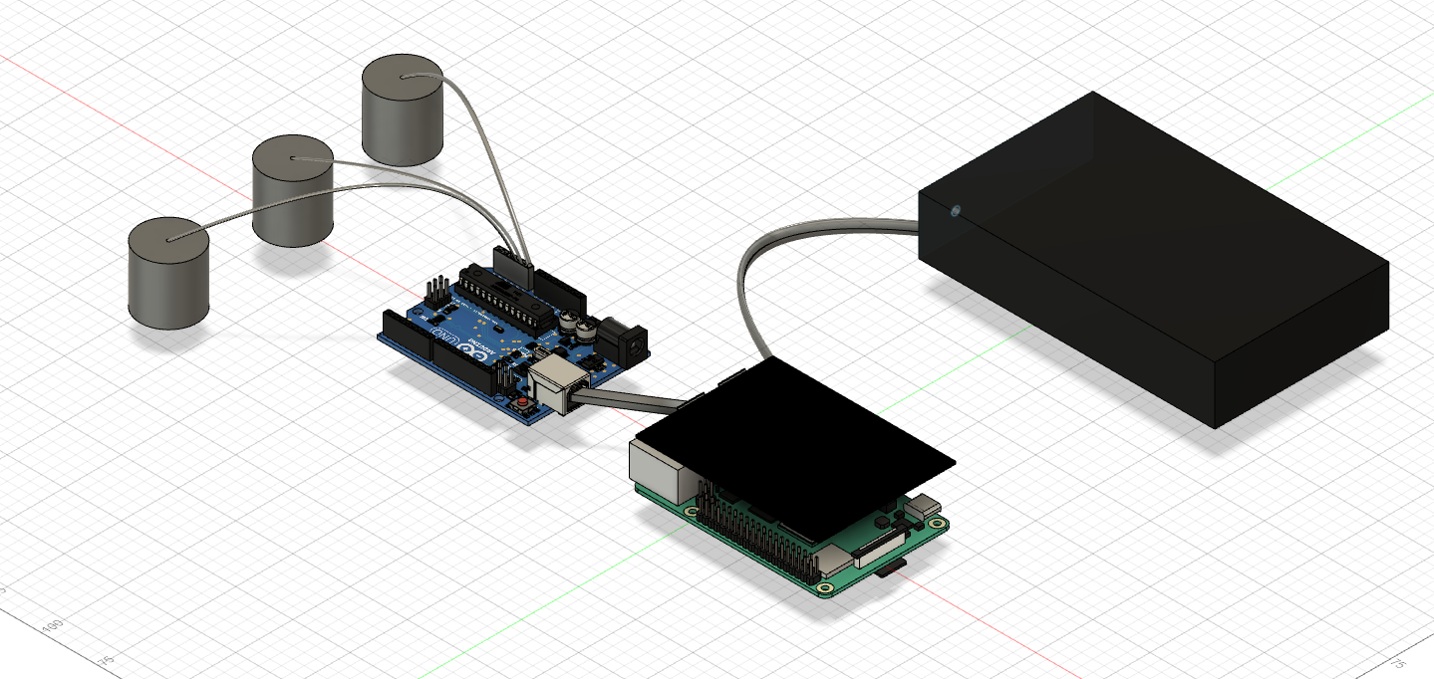
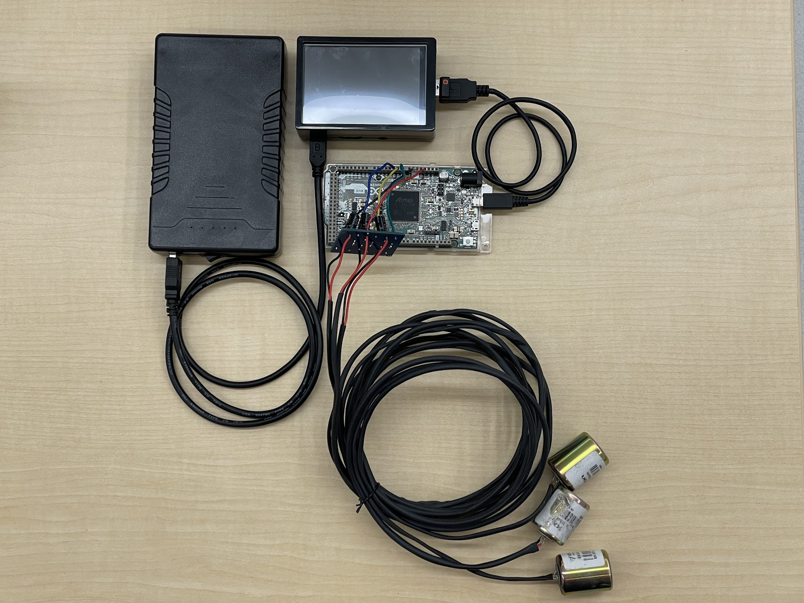
System of Networked Sensors for Detection and
Characterization of Underground Activity
Augustus Standeven, Tyler McKean, Yohannes Kidane, Vulindsky Fanfan
Motivation
Design Description
Design Validation
Results
The detection of unauthorized underground activity is costly, complex, time consuming to set up, calibrate, maintain, and often difficult to interpret, resulting in an output of ambiguous information. Factoring for these obstacles, our team was committed to designing a cheaper and more accurate sensor array that can detect and characterize underground vibration activity than the available market systems. Our goal was to create a system that is portable, cheap, easy to setup, and user friendly with the intention that the project could be scaled up in size for another Senior Design Team in the future.
Project Definition
References

